Slide 1
ist 263
Exam 1 and Photoshop

Slide 2
Agenda
Exam 1 Review
Image Types
Image Sizes
Photoshop Walk Through

Slide 3
Exam Review

Slide 4
Review
Exam Guide
Question Sheet
Syntax Sheet

Slide 5
Review – Sample Short Answer Code
Write HTML code that produces the following in your web browser:
Oranges
Apples
Bananas

Slide 6
Review – Kahoot Quiz
Link is in Blackboard under Unit 05 > Exam: Wednesday > Kahoot Quiz

Slide 7
Image Types

Slide 8
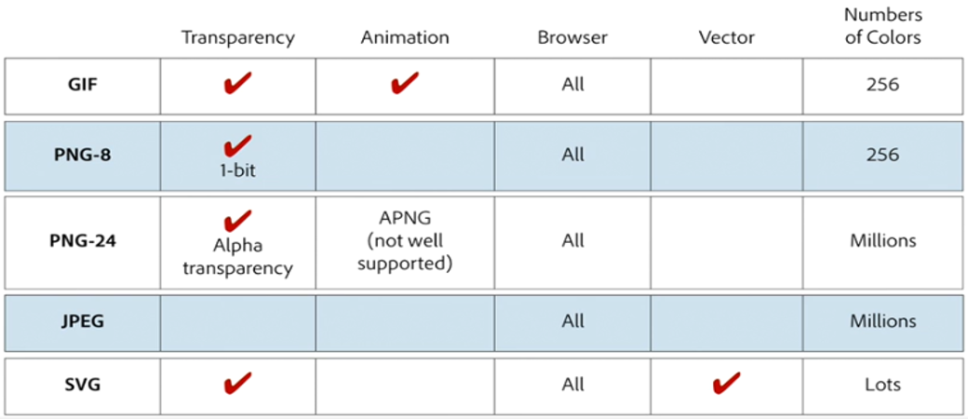
The Formats

Slide 9
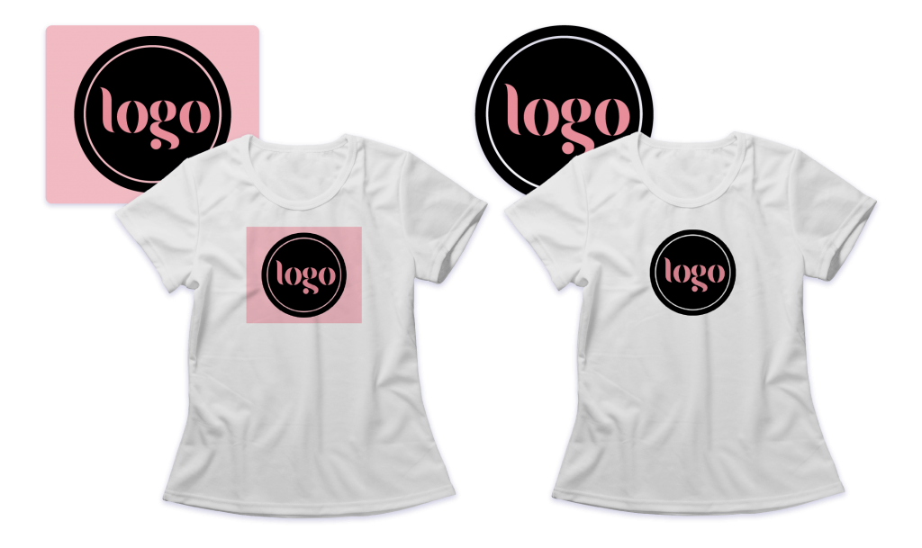
Transparency

Slide 10

Transparency

Slide 11
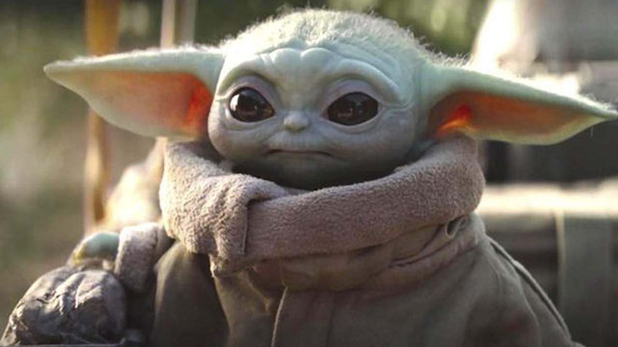
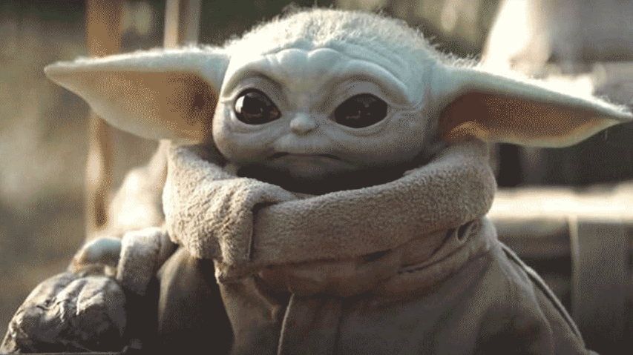
Number of Colors

Slide 12
Number of Colors

Slide 13
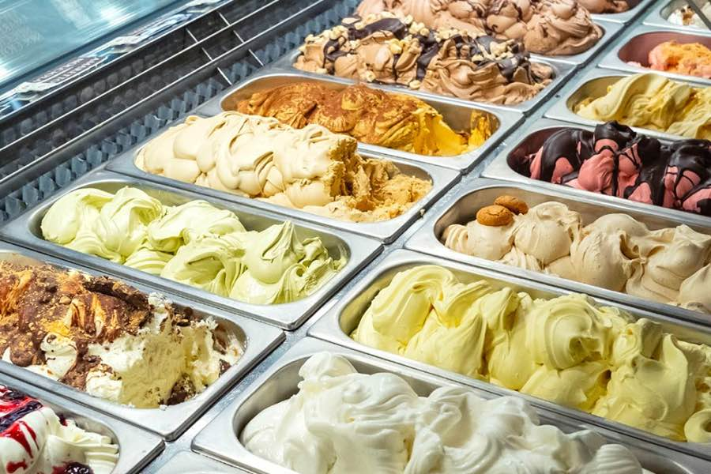

Image Type Examples
GIF
Fewer colors
Animation
Transparency
JPG (or JPEG)
Unlimited colors
Primarily photos
No transparency (must be rectangular)

Slide 14
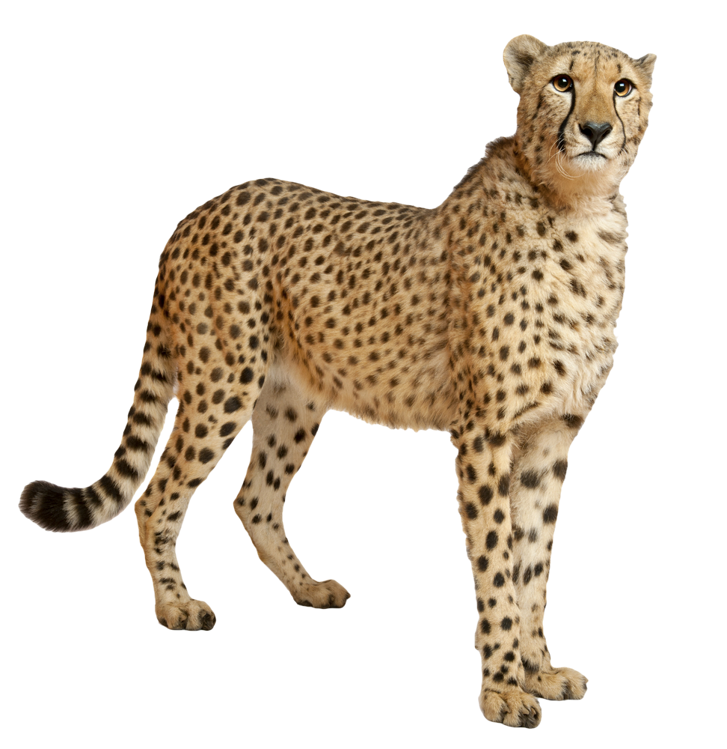

Image Type Examples
PNG
Millions of colors
No animation
Transparency

Slide 15


Image Type Examples
SVG
“Scalable Vector Graphic”
Millions of colors
No animation
Transparency
Solid color images, not meant for gradient images (like photos)

Slide 16
Image Sizes

Slide 17

Pixels
This emoji is made up of dots of color
A pixel is one dot in an image
There are 72 pixels per inch on a screen
The number of pixels per inch is abbreviated PPI

Slide 18
Dimensions
|------------------------- width -------------------------|
|------------ height ------------|

Slide 19


Pixelated Image

Slide 20
Image Look and Feel

Slide 21

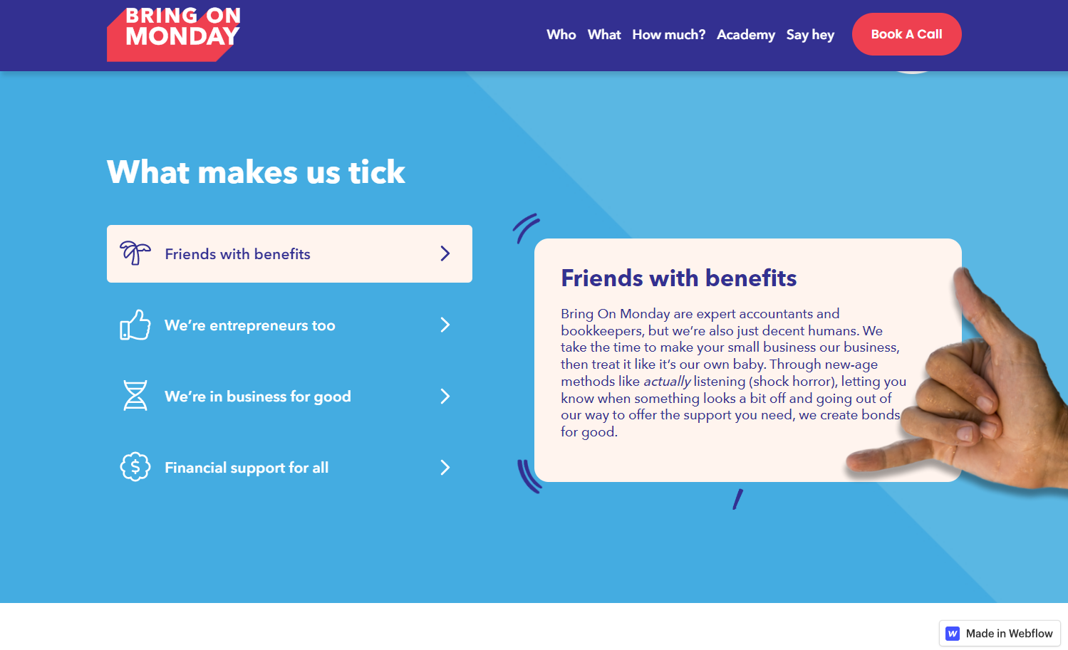
Images can define the mood of a site
Relaxing Coffee Shop
Helpful business systems

Slide 22
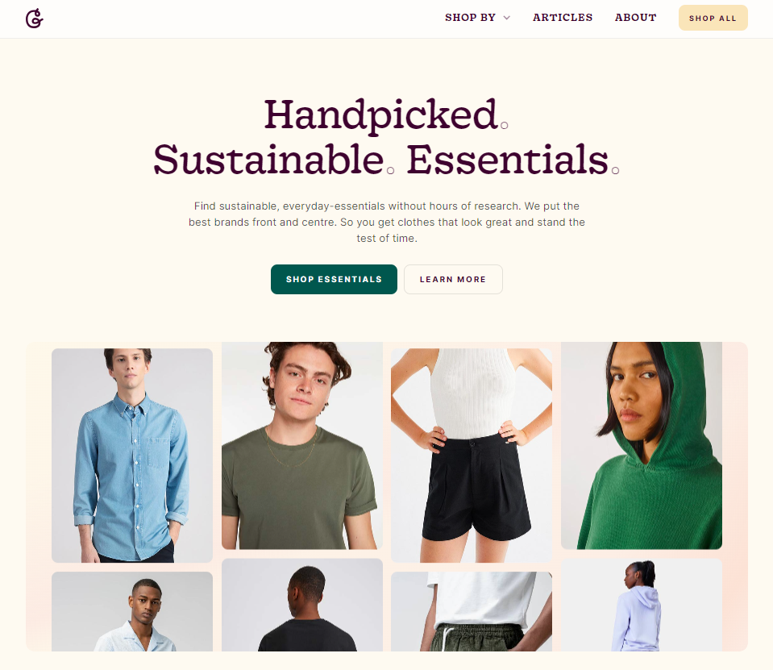
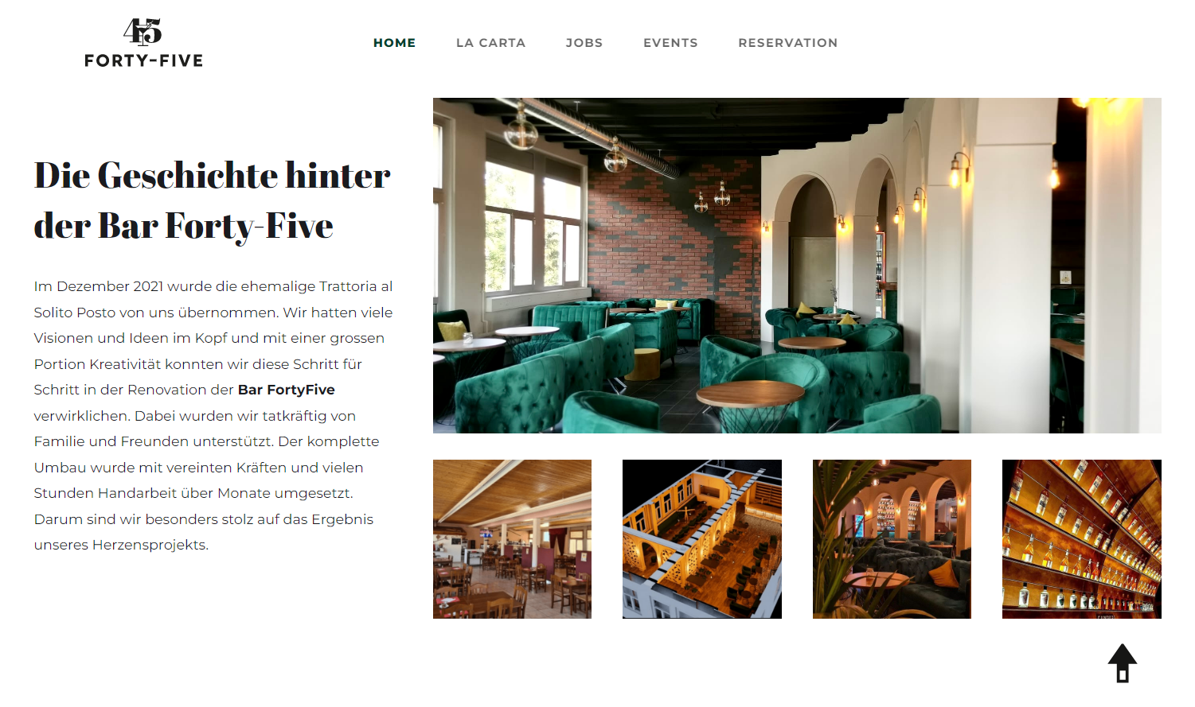
Images can define the mood of a site
Upscale nightclub
Online clothing outlet

Slide 23
Photoshop Walk Through
(time permitting)

Slide 24
Photoshop Walk Through
Crop Image
Resize Image
Save for the Web

